Slide 1
Epitaxial Growth- An Introduction
Mark Hopkinson
University of Sheffield(UK)

Slide 2
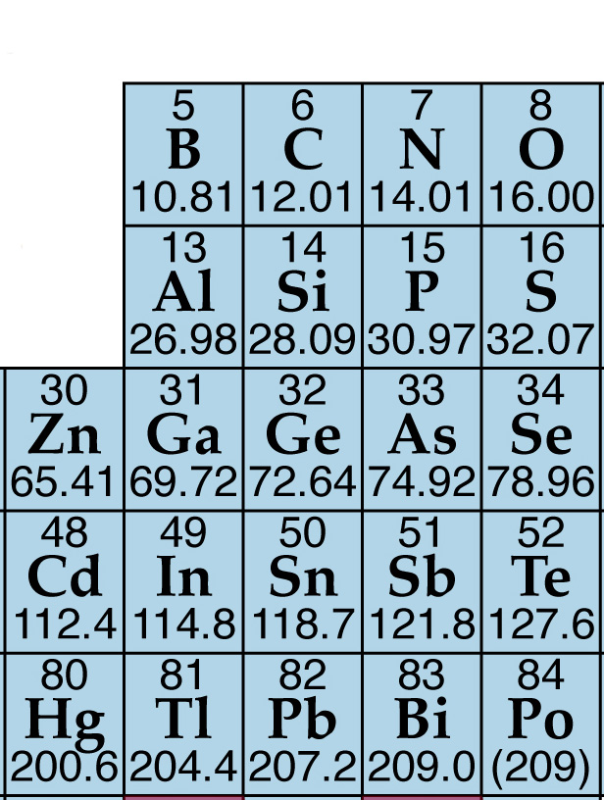
Semiconductor Materials
Semiconducting materials are comprised of covalently bonded elements from the IV-IV, III-V, II-VI columns of the periodic table which form stable crystal configurations
II III IV V VI
Si, Ge, SiGe
(Diamond)
IV
III-V
GaAs GaN
(Zincblende -Wurtzite)
II-VI
CdTe ZnSe
(Rocksalt)

Slide 3
So how do we produce these semiconductor materials?
The simplest method is bulk crystal growth
We take bulk elements and heat them under pressure until the liquid reaches supersaturation
Then the introduction of a ‘seed’ crystal initiates the build-up of new crystalline material

Slide 4
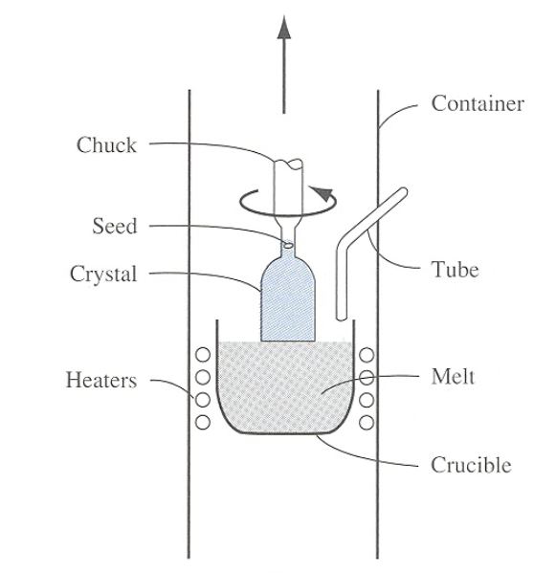
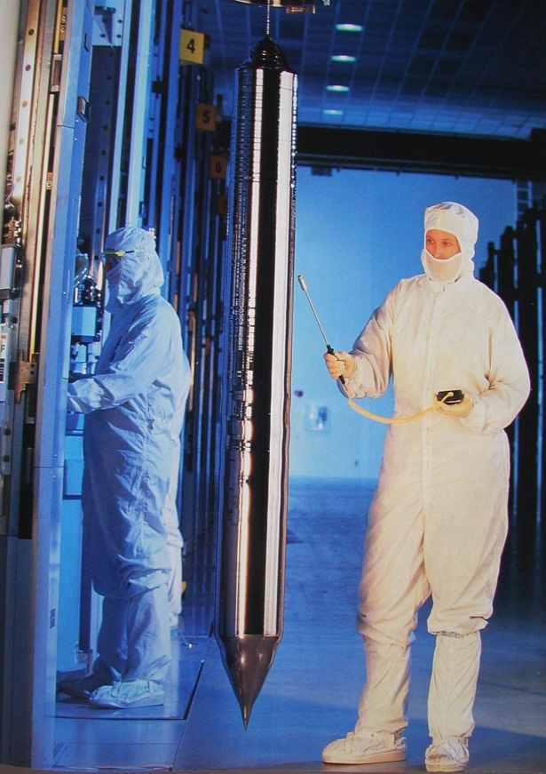
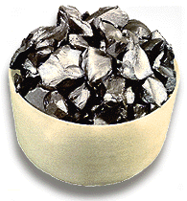
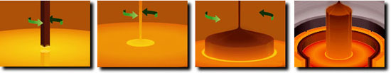
Materials Synthesis
The usual bulk growth process is the Czochralski method

Slide 5
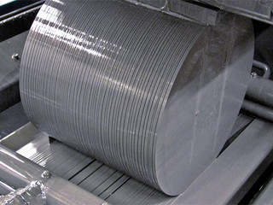
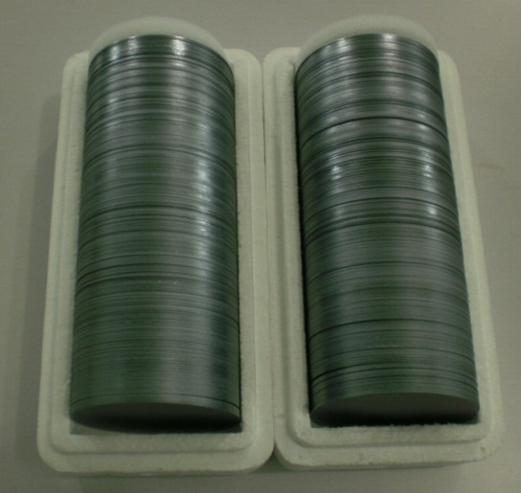
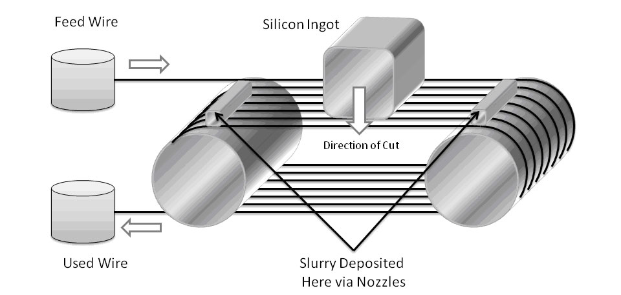
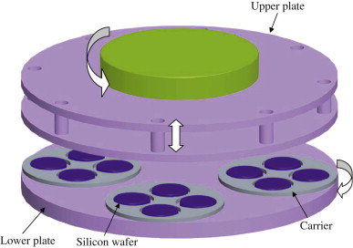
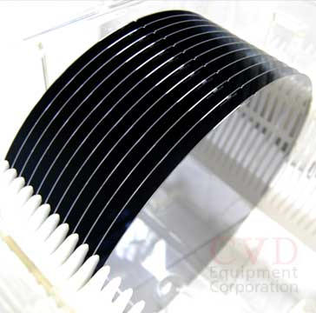
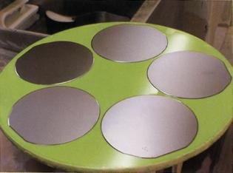
Materials Synthesis
The resulting ingots are cut with a diamond wire saw
Then lapped and polished

Slide 6
Problems with this approach
Thermodymically impossible to produce many compound substrates using this approach
Many compounds have a highly reactivity at high temperature
We only produce single elements and compounds- there is much to be gained by combining semiconductors in heterostructures
For this we need an additive (epitaxial) growth approach

Slide 7
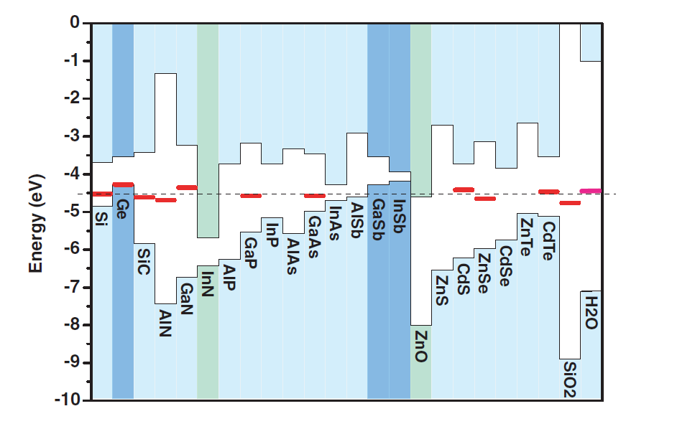
Heterostructures
Bulk materials have many interesting properties, but real success story of semiconductors is the use of heterostructures of two or more compounds and in particular the combination of a low band gap material with a wide gap one which provides carrier confinement.
Compound semiconductors offer a wide range of relative band alignments, giving considerable freedom in terms of band structure engineering
C. Van der Walle Annu. Rev. Mater. Res. 2006. 36:179–98

Slide 8
Heterostructures
A heterostructure is a sandwich of compatible materials. The usual way to form this is by means of add-on growth or epitaxy.
Consider deposition from the gas phase on to a surface. We simply switch the gas species over and then switch back, producing a double heterostructure (or if in the nm-range single quantum well)
Energy

Slide 9
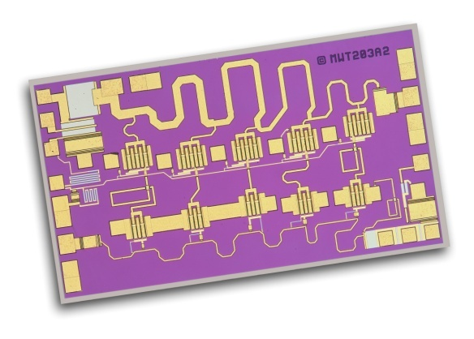
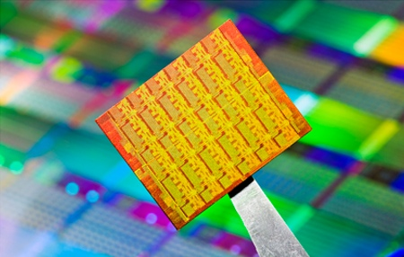
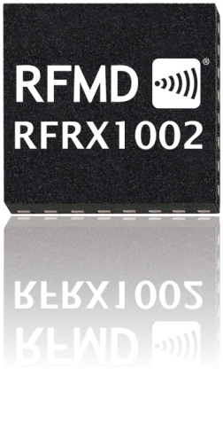
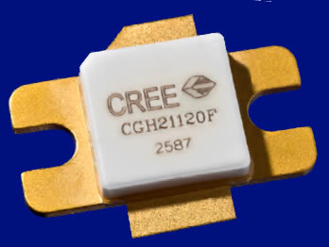
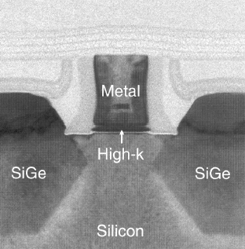

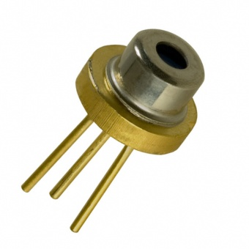
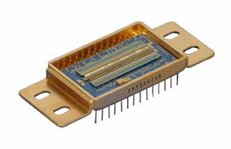
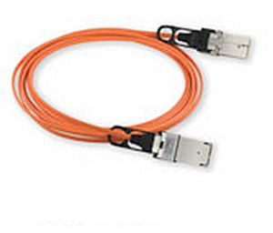
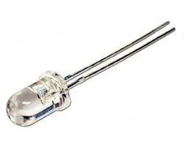
Heterostructures
Many modern electronic and photonic devices contain hetero-structures of two or more materials . They also have precisely positioned doping layers, all produced by epitaxial methods.
III-V electronic devices (pHEMT, HBT)
III-V photonic devices (LED, laser, photodetector)
Si/SiGe CMOS

Slide 10
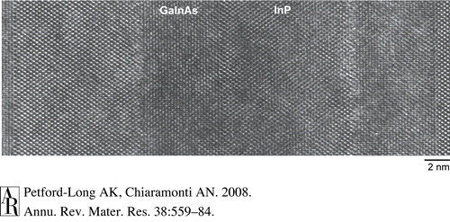
Heterostructures
Example: InGaAs on InP:
InGaAs is lattice matched to the InP lattice constant (0.587nm) at a composition of In_{.53}Ga_{.47}As.
Very abrupt interfaces (roughness ~0.5ML) are easily demonstrated

Slide 11
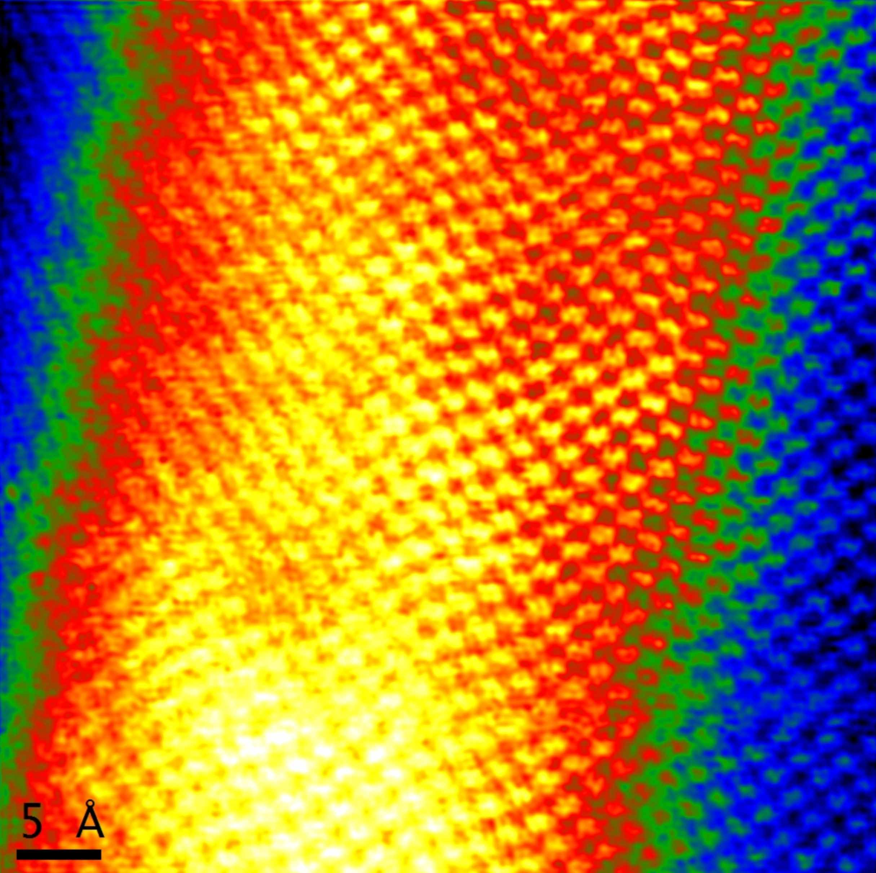
Heterostructures
Example: In_{x}Ga_{1-x}As_{1-y}N_{x} Pseudomorphic on GaAs:
x ≈0.35, y≈ 0.02.
ε~ +1.5%
Fairly abrupt interfaces (roughness ~2-3ML)

Slide 12
Heterostructures
Heterostructures are formed by combing materials with closely similar lattice constants (eg: GaAs and AlAs, or InP and InGaAs).
However an extension can be made to different lattice constant materials providing the lattice mismatch is not too high and the thickness is not too great. In this case so called pseudomorphic growth may be achieved.
a// = asub
ac
◉

a┴>ac
○
○
○
○

=

+
asub
asub
Hydrost.
Uniax.
The epilayer becomes biaxially strained. This can be thought of as a combination of hydrostatic strain, which modifies the band gap and uniaxial strain which lifts the degeneracy of the valence band.

Slide 13
Heterostructures
However if the strain-thickness product is too high we will induce relaxation in the structure. There are three basic types:
Plastic relaxation- introduction of crystal defects
Elastic relaxation- deformation of the surface
Composition relaxation- promotion of phase separation
Plastic Relaxation → Crystal defects (dislocations, twins, stacking faults). These play a major role in device degradation.
e.g: in electronic devices, a space charge region exists around a dislocation which scatters carriers & traps carriers. In optical devices dislocations introduce states in the gap, acting as non-radiative recombination centres.

Slide 14
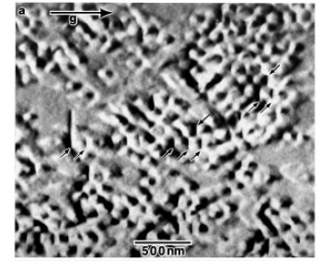
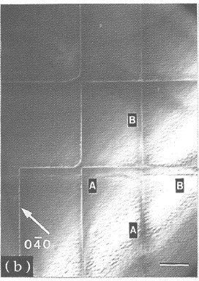
Plastic Relaxation
Dislocations are commonly observed in pseudomorphic systems.
Cross section
Plan view
Surface loops (Matthews type)
GaAs
GaAs
Threading dislocation
Ph.D Thesis C. Guerret Piécourt LAAS (Toulouse)

Slide 15
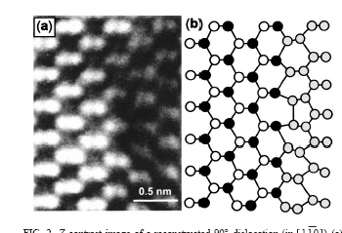
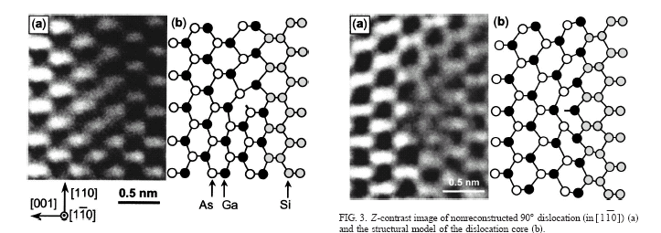
III-V Heterostructures
Dislocations may also be present at the hetero-interface (eg: GaAs on Si)
Lopatin et al. APL 81 5, 7 OCT. 2002, P. 2728
STEM-Z C + model of 90° dislocation
STEM-Z C + model of 90° dislocation
STEM-Z + model of 60° dislocation

Slide 16
Elastic Relaxation
Distortion of a layer by elastic relaxation is much more likely to affect a thin epitaxial layer than bulk materials
Volmer and Weber (1929) observed that crystalline films grow from 3D nuclei.
Stranski and Krastanov (1938) that a layer could initially grow 2D up to a critical thickness, beyond which 3D islands would form and take up their natural lattice constant.
Frank and van der Merve (1949): Identified that monolayer-by monolayer growth would always tend to dominate for a layer below a critical misfit level
These modes were unified by Bauer (1958) by consideration of the the macroscopic free energies.

Slide 17
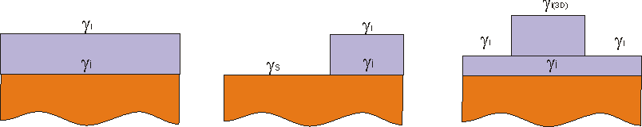
Elastic Relaxation
γ_{l} free energy of the layer-vacuum interface
γ_{i} free energy of the layer-substrate interface (contains components due to lattice mismatch and the overall volume of the strained layer)
γ_{s} free energy of the substrate-vacuum interface
FvdM mode occurs if γ_{l +} γ_{i ≤} γ_{s}
For homoepitaxy: γ_{l ≈}γ_{s and} γ_{i=0} For heteroepitaxy: γ_{l <}γ_{s since} γ_{i=+ve}
VW mode
Occurs if γ_{l >}γ_{s}
SK mode
Occurs if initially γ_{l <}γ_{s}
but then γ_{l}
increases monotonically with thickness
Growth modes
FM VW SK

Slide 18
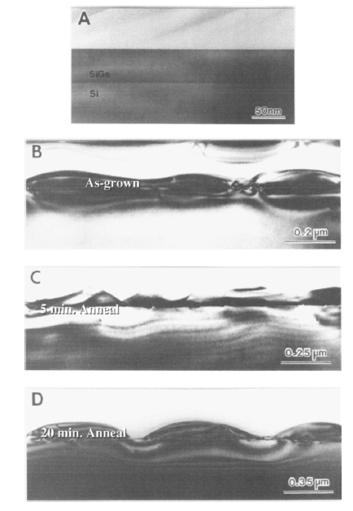
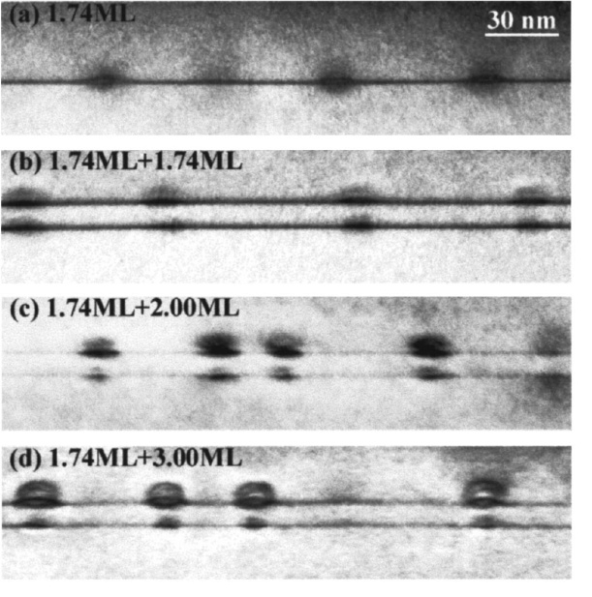
Elastic Relaxation
3-dimensional growth modes (SK)
3D transition at the growing surface
3D transition after growth (with annealing)

Slide 19
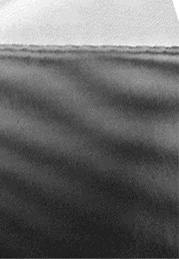
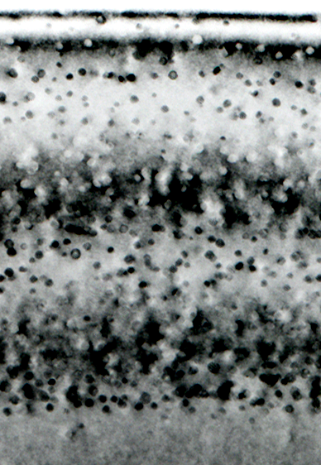
Compositional Relaxation
Composition relaxation instability
100 nm
Surface
surface
GaAs low temperature (non stiociometric ~ 1 % As excess)
Same layer after annealing
at 750°C, 2h
GaAs substrate
Internal strain induces interdiffusion and separation of phases

Slide 20
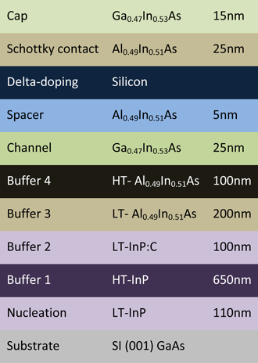
Epitaxy
The term ‘Epitaxy’ comes from the Greek Epi- “over, on top” and taxis “order”.
Epitaxial growth proceeds by replication of an existing crystal surface; usually a bought in wafer.
We add to this wafer layers of different composition or doping, building up a layer by layer structure like the GaAs HEMT structure shown right
Most methods are variants of physical vapour deposition in which elements or compounds react and then condense on a surface.

Slide 21
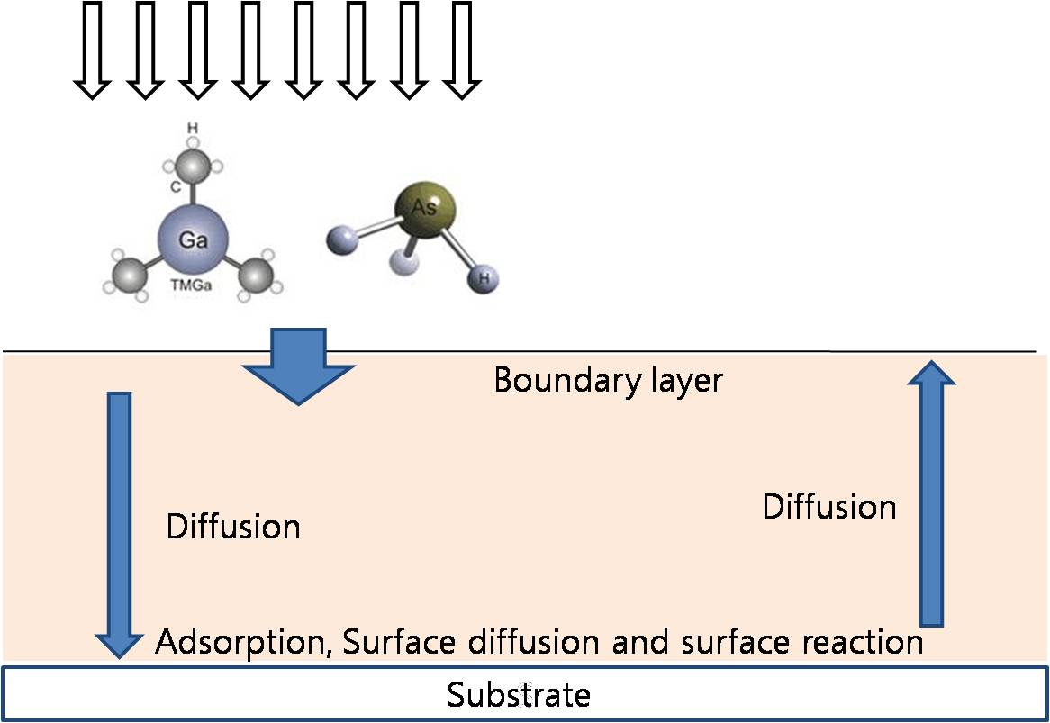
Epitaxial Technologies
Vapour phase epitaxy (VPE): uses vapour phase precursors (hydrides, halides, organic compounds)
These need to be transported to the growth surface, chemi-absorbed to the surface, reacted and then the resulting waste products need to be removed
In the most simple form of CVD pre-cursors are injected into a chamber where they decompose & react on the surface of heated wafers.

Slide 22
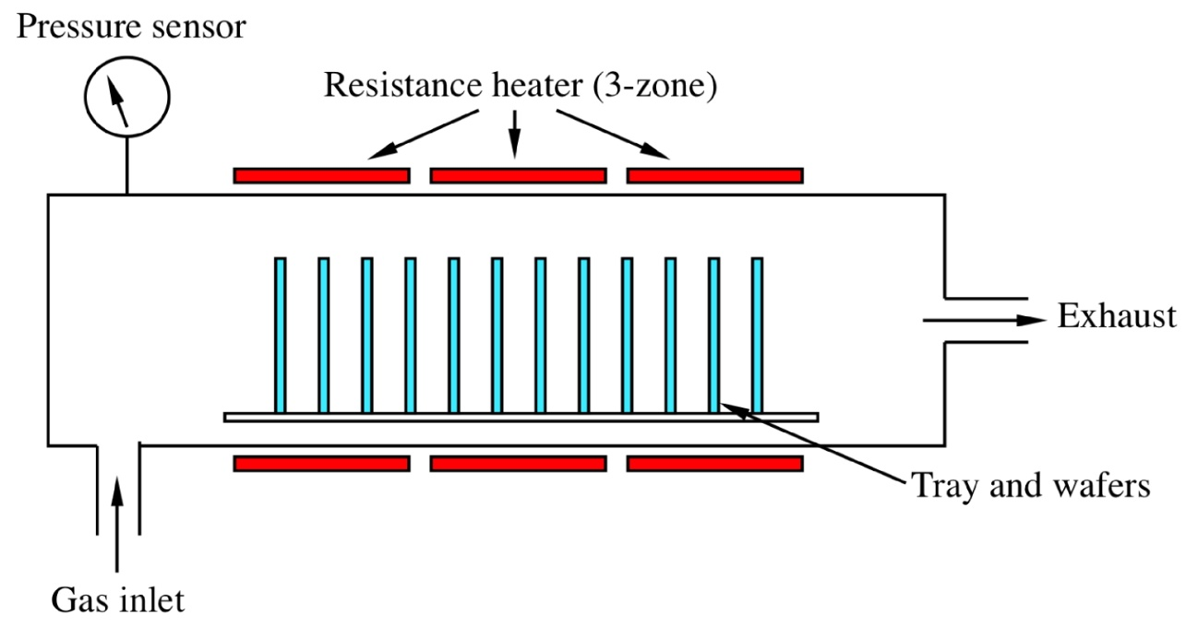
Epitaxial Technologies
If the layers are relatively thick and unstructured then a large hot-wall barrel reactor containing many stacked wafers is perfectly adequate. These type of reactors are the mainstay of the silicon industry
SiH₄ →Si + 2H₂↑
SiH₂Cl₂ →Si + 2HCl↑

Slide 23
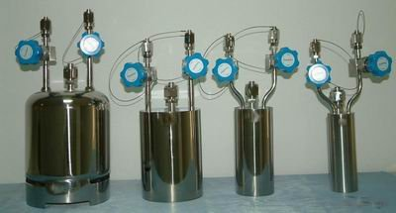
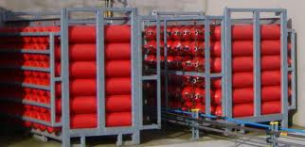
Epitaxial Technologies
For many of the Grp II and III metals there are no naturally occuring vapourisable precusors. However it is possible to sythesise metalorganic precursors of the form M.(CH₃)_{n}
This the basis of metalorganic vapour phase epitaxy (MOVPE)
eg: Ga(CH₃)_{n} + AsH₃ →GaAlAs + n(H₂ + CH_{x})
Ga(CH₃)_{n}+ NH₃ → GaN + n(H₂ + CH_{x})
Metalorganics Hydrides

Slide 24
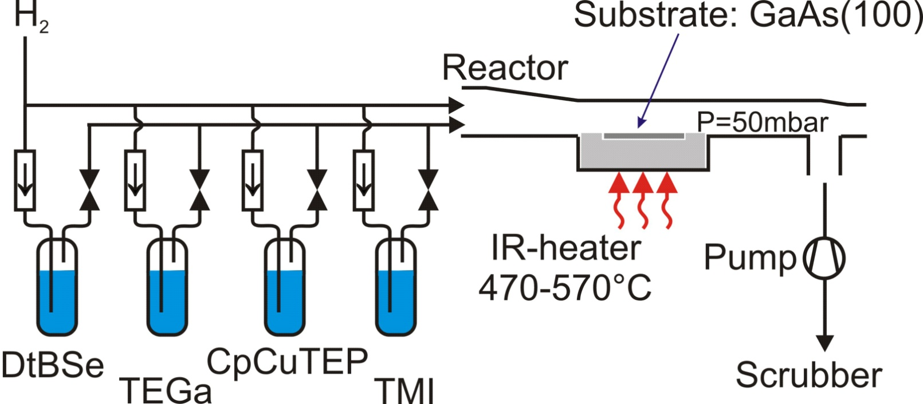
Epitaxial Technologies
AsH₄
Metalorganics (metals, dopants)
Traditional MOCVD systems use a quartz reactor into which the gas- vapour mixture flows towards an exhaust. Because of the directional nature of the flow, these systems are not well suited to multiple wafers and so have been largely replaced by overhead injection systems (showerheads)

Slide 25
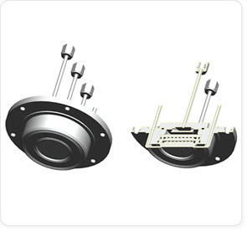
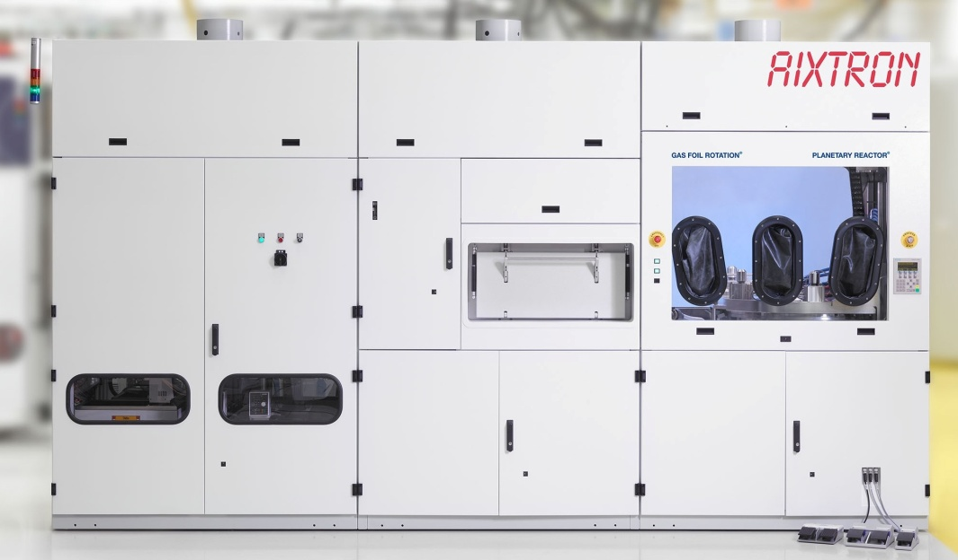
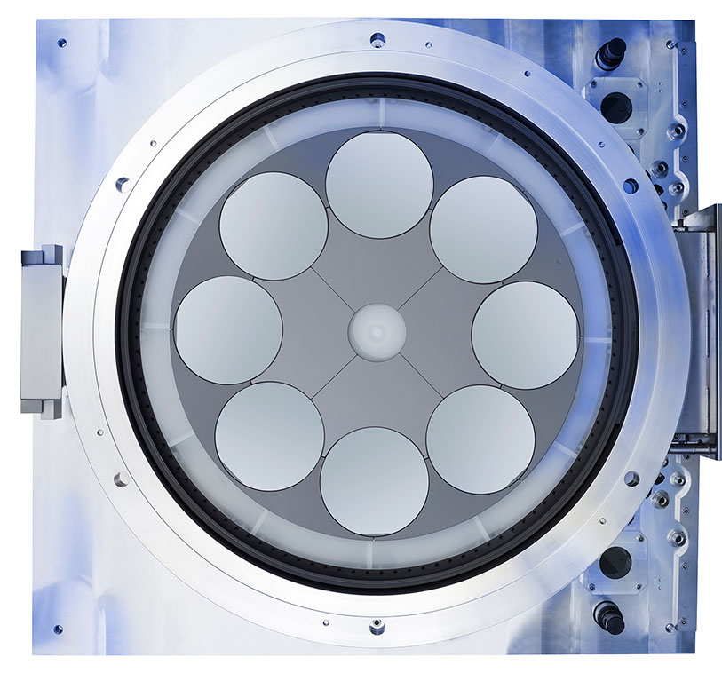
Epitaxial Technologies
These multiwafer MOCVD systems are dominant in the InP and GaN semiconductor optoelectronic market, together with some usage in electronic device applications.

Slide 26
MOVPE has a number of attractive properties.
Epitaxial Technologies
It is quite easy to refine materials in their gas phase- high quality source materials
Easy to handle & switch gas flow mixtures and there are very accurate direct means to measure gas flow rates.
Hydrogen carrier gas provides a strongly reducing environment
Its use of vacuum technology is less demanding than MBE.
It has capabilities for both very low (<nm.s⁻¹) and relatively high (μm.min⁻¹) growth rates
Surface Long diffusion lengths, giving excellent selectivity, ability to change growth modes etc

Slide 27
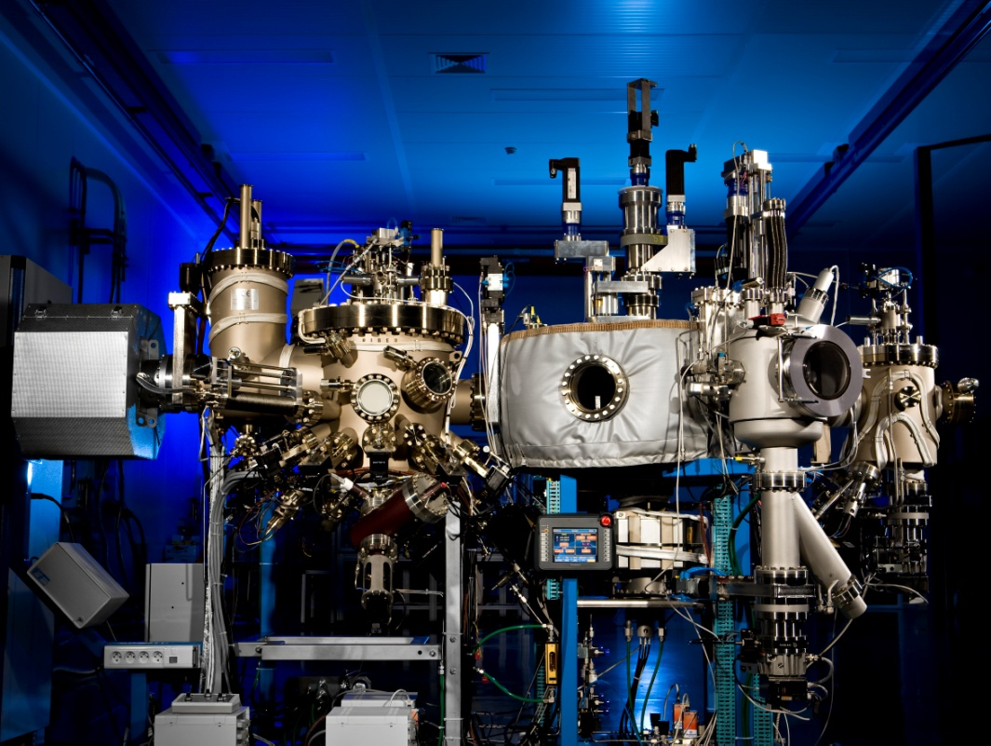
Epitaxial
Molecular beam epitaxy (MBE): uses a molecular beam of evaporated vapour molecules : eg: Ga, Al, As (actually Ga₂, Al_{2,} As₄⁾ Includes only the individual species involved in the growth*, which then directly react on the surface.
*variants of MBE exist which use hydride gas for the group V (Gas source MBE) or both hydrides +metalorganics (Chemical Beam Epitaxy- CBE)
MBE is simply physical vapour deposition under molecular flow conditions
eg: Ga₂ + As₂ → GaAs
Ga₂ + N₂* → GaN

Slide 28
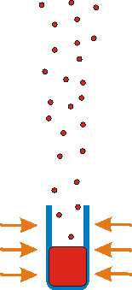
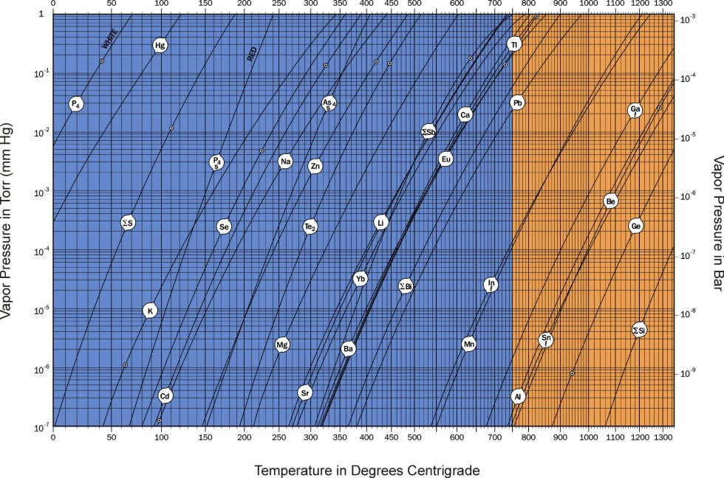



Epitaxial Technologies-MBE
In the simplest form of MBE, a vapour is created by heating pure elements inside a crucible. The resulting vapour condenses on a heated substrate. Simple mechanical shutters provide switching between species.
www.veeco.com/mbe

Slide 29
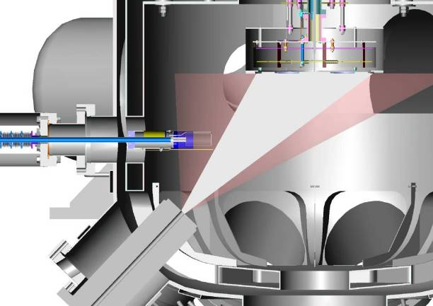
Epitaxial Technologies- MBE
A typical MBE machine consists of the following
A stainless steel vacuum chamber, usually doubled-walled with LN₂ cryogen inside, pumped to 10⁻¹⁰mbar or better
A Heated rotating substrate, with vapour sources directed towards the substrate and shutters for each source
Other items
Transfer/Manipulation
Pressure monitoring
Growth monitoring (eg: RHEED, pyrometry, reflectivity)
Source: Oxford Instruments Ltd

Slide 30
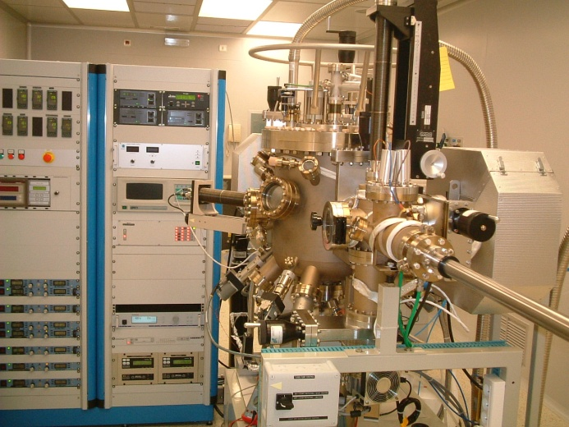
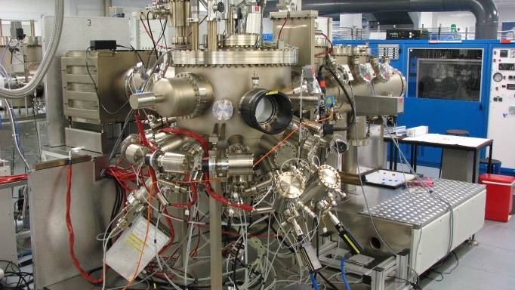
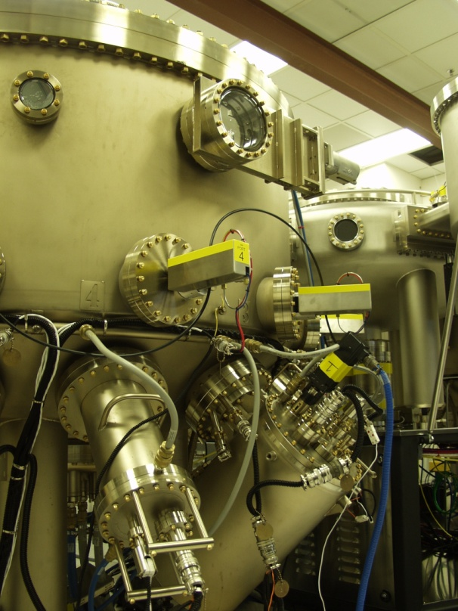
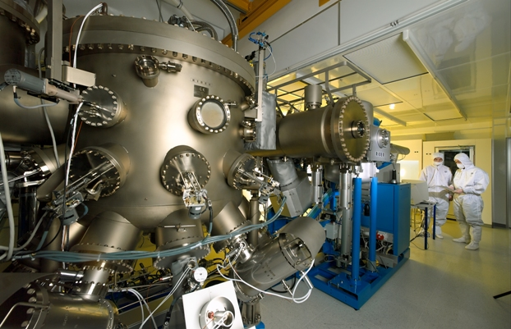
Epitaxial Technologies- MBE
From small research systems to mass production (7x 6inch)
RIBER compact 21 (UPM)
VG V90 (Sheffield)
Veeco GEN 2000 (IQE)
RIBER 6000 (RIBER factory)

Slide 31
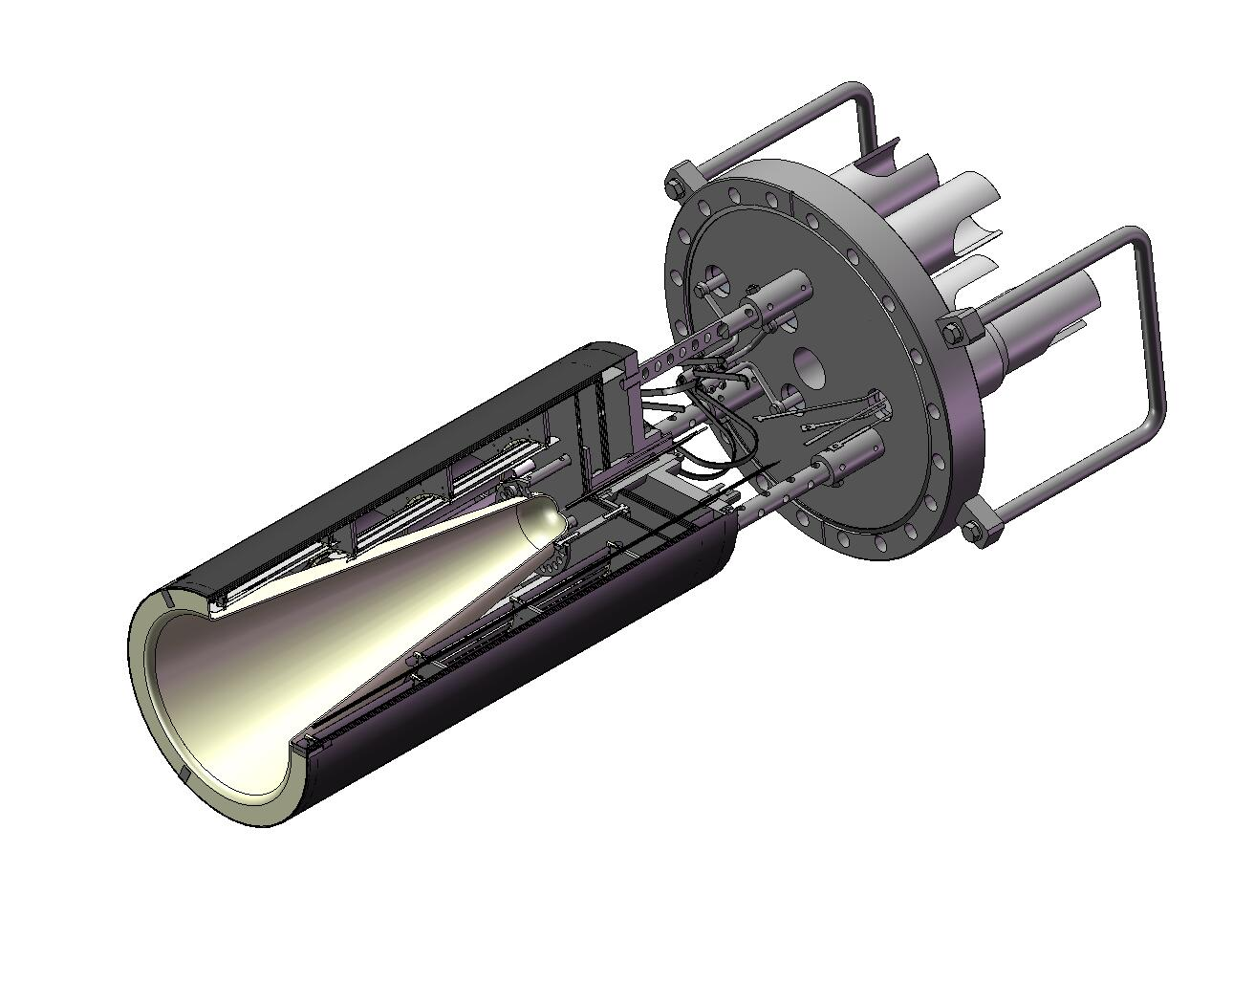
Epitaxial Technologies -MBE
It is important that the source cells provide an accurate & stable vapour temperature, so significant effort goes into their design. Many of the source materials are highly reactive at high temperature- use inert materials such as pyrolytic boron nitride.
RIBER SA
The growth rate is a function or the vapour pressure, of the source, P_{s} and the geometry
substrate
0
x
Flux emitted by cell:
F_{r} = P_{s} / (2mkT)^{1/2} . Π r² f(θ)
h
θ
Flux recieved by subs:
F_{r} = F_{e} h² / (h+x²)²). (cos θ +x/h.sinθ)
Growth rate:
Where ξ is the sticking coefficient (0-1)
 F_{r} ~ F_{e} / h²
F= ξ F_{r}
Effusion Cell

Slide 32

Epitaxial Technologies- MBE
Mean free path (cm)
10⁸
10⁴
1
MBE requires molecular transport
Collisions with residual gas molecules would interfere & react with the flow of vapour species.
10⁻¹⁰ 10⁻⁶ 10⁻²
P = 10⁻⁶T
Pressure (Torr)
300K
P = 10⁻⁸T mfp = 14cm
If the source- substrate distance is more than 14cm, at least one collision with residual gas molecules will occur
Need Ultra high vacuum (UHV) conditions (P=10⁻¹⁰T of better). In MBE this is provided by external pumping and internal cryopumping using liquid nitrogen. Also the system must be baked.
Residual contaminants  H₂O, CO, CO₂
P = 10⁻¹⁰T

Slide 33
Epitaxial Technologies- MBE
Even with UHV, there is a risk that residual gas impurities could incorporate into the layer giving rise to unintentional doping or acting as recombination centres.
Consider the density of incorporated impurities caused by a partial pressure of impurity vapour species (eg: of carbon)
10¹⁸
ξ = 10⁻¹
We are very lucky that the sticking coefficient of carbon (p-type dopant, minority carrier trap) is quite low (ξ_{carbon} ~10⁻³)
n (mol..cm⁻³ )
ξ = 10⁻²
10¹⁶
ξ = 1
ξ = 10⁻³
ξ = 10⁻⁴
ξ = 10⁻⁵
10¹⁴
ξ = 10⁻⁶
ξ = 10⁻⁷
10¹²
10⁻¹⁶ 10⁻¹⁴ 10⁻¹² 10⁻¹⁰ 10⁻⁸
Partial Pressure of Impurity (T)

Slide 34
Epitaxial Technologies- MBE
Achieving and retaining UHV is of critical importance in MBE and this all adds to the complexity and cost.
MBE characteristics
Ultimate in purity (for those who invest the effort and money)
Abrupt switching, coupled with relatively slow growth rates: good for nanostructures
Relatively low growth temperatures: Low thermal budget, Reduced interdiffusion
In-situ (in vacuum) diagnosis: Mass spectrometry. Electron diffraction analysis of surfaces (RHEED), Surface spectroscopy etc
Potential to transfer to other vacuum processing tools eg: other semiconductor, metallisation, etching.

Slide 35

Basics of Epitaxy
Epitaxy takes place on a substrate cut and polished from a bulk ingot (generally along a high symmetry axis)
Whatever the surface, it can never be atomically flat. It will consist of monolayer steps and with flat terraces in between. On an atomic scale, this presents a number of sites at which new growth could nucleate
B.A. Joyce et al. Materials Science & Engineering B 67 (1999) 7

Slide 36
Basics of Epitaxy
The relative binding energies of infilling holes and kinks on the surface is larger than that of adding to islands. This leads (fortunately) to a preference for layer-by-layer growth, providing the monomers can reach the preferable sites.
To acquire the most favourable sites the incoming monomers require surface diffusion. Surface diffusion is characterised by a diffusion length (λ) which obeys the Einstein relation where D is the diffusion coefficient and τ is the diffusion time. Diffusion takes place in a step-by-step fashion, each time overcoming an atomic barrier. These lead to a typical activated process, Clearly the growth temperature needs to be ˃E_{A} to have adequate surface diffusion
.

Slide 37

Basics of Epitaxy
Every practical wafer surface will have surface steps.
There is competition between nucleation at surface steps (energetically favoured) and nucleation on the terraces, which can introduce its own steps
The relative proportion (α) of monomers reaching a step edge is dependent on the terrace width (w) and the diffusion length (λ) and is given by the Burton, Cabrera and Frank (BCF) theory.
island
step flow
)

Slide 38


Basics of Epitaxy
Step flow growth will be favoured if there is:
A significant density of steps
and/or Large diffusion lengths
High density of surface steps due to miscut
Other potential steps; eg: spiral sources
But just to make things more complicated , there is a tendency of surfaces to step-bunch caused by the presence of a barrier (the Schwoebel barrier) for the motion of atomic steps

Slide 39
Basics of Epitaxy
So what is better, step flow or island growth?
Ideal step flow always proceeds through the completion of a monolayer before the growth of the next one begins. In this way the crystal surface remains two dimensional in nature and is abrupt to ±0.5ML (~ 0.15nm). This is important for the production of high quality two dimensional heterostructures.
Growth by island nucleation does not involve the completion of one layer before another one can start. It can therefore be susceptible to roughening and clustering processes. However the roughening processes are self-limiting and you can in controlled conditions get good epitaxial growth.

Slide 40
Basics of Epitaxy
Chemical potential
The energy of bonding is characterised by the chemical potential. Considering GaAs as an example, according to the theories of Gibbs the chemical potential of GaAs, µ_{GaAs} , must be equal to the sum of the free elements , µ_{Ga} + µ_{As} otherwise the bulk would be unstable to the loss of one of the elements.
Also the chemical potential of the free elements must be lower than that of the bulk elements.

Slide 41
Basics of Epitaxy
therefore, µ_{Ga} < µ_{Ga, bulk} and µ_{As} < µ_{As, bulk}
It is useful to consider the differences in chemical potential from the bulk values, Δ µ_{Ga} = µ_{Ga­}- µ_{Ga, bulk} < 0 and Δ µ_{As} = µ_{As­}- µ_{As , bulk}< 0
Considering GaAs:
µ_{GaAs, bulk}- µ_{Ga, bulk}- µ_{As, bulk}= Δ µ_{Ga}+ Δ µ_{As} < 0.
The first term is simply the energy of formation of GaAs, -ΔH_{GaAs}
This is well known to be ≈ 0.80eV per molecule. Two extremes can now exist.
If Δ µ_{Ga} → 0 then Δ µ_{As} → - ΔH_{GaAs}. In this situation there is no energy difference between free Ga and Ga in bulk GaAs. Metallic Ga droplets form on the surface in this Ga rich growth condition.

Slide 42
Basics of Epitaxy
Under As rich conditions Δ µ_{As} → 0 then Δ µ_{Ga} → - ΔH_{GaAs}.
This excess As can be a problem for high-quality growth. However such grpV-rich conditions are generally favoured.
In GaAs, as well as many other III-V materials, growth in between these two extremes results in a large number of surface reconstruction phases.
We may vary these potentials by controlling the partial pressure of the elements. Under As rich conditions (Δ µ_{Ga} →0.8eV) we find the lowest lying energetic levels, and therefore the most stable. These are the well known c(4x4) and β(2x4) reconstructions.
Calculated using density functional theory (DFT)

Slide 43
Basics of Epitaxy
Note under As-rich conditions, which are typical, one is basically saturating the surface with As. Under this situation it is possible to treat the growth as the adsorption and diffusion of Ga on the surface, with the excess As just ‘waiting’ for the Ga to incorporate.
The growth rate is then determined by the Ga flux, with the excess As having a secondary role.
Surface Reconstructions
The surface of covalent crystals is comprised of unsatisfied dangling bonds. Rather than retain the bulk geometry, the surface atoms are prone to re-arrange themselves to lower their surface energy. These are called surface reconstructions.

Slide 44
Basics of Epitaxy
Surface reconstructions can have significantly different structure of stoiciometry to the bulk. They play an important role in the epitaxy, since incoming monomers are interacting with the surface and not the bulk .
The nomenclature of surface reconstructions reflects the symmetry in multiples of the original unit cell basis. For the most common (001) surface reconstructions such as the (2x4) reflect a surface unit cell of 2 times
Our primary means on observing these is through surface electron diffraction- Reflection High Energy Electron diffraction (RHEED). Their effect on the optical anistropy can be also observed in Reflectance Anistropy Spectroscopy (RAS)

Slide 45



Basics of Epitaxy
RHEED
Flourescent screen
Ga
As₄
Shadow edge
E-gun
surface
θ = 1-3°
Grazing incidence electron beam(1-3°)
◉
Diffraction from surface at the Bragg condition
2dsinθ = nλ
θ = 1-3°
surface
Specular beam
Shadow edge
Direct beam

Slide 46
Basics of Epitaxy
Example: GaAs (001) surface- (2x 4) reconstruction
Top View
Before
After
<110>
<110>
<001>
Side view
<001>
<110>
<110>
(2x4) reconstruction larger than origonal lattice smaller reciprocal lattice
 Addtional lines in the RHEED

Slide 47
Basics of Epitaxy
Transitions in the surface are a good measure of the thermodynamics
e.g: As rich versus Ga rich- reconstruction rotates- (2x4) goes to a (4x2) at a well know temperature and pressure
As rich
<110>
Ga rich
F_{As} 
<110>
<001>
<001>
<110>
<110>

Slide 48


Basics of Epitaxy
In the RHEED diffraction image there is a series of reciprocal lattice
diffraction rods perpendicular to the surface reconstruction
e g: (2x4) to (4x2) transition
Temperature
Pressure
<110>
4 fold periodicity – x4
2 fold periodicity – x2

Slide 49






Basics of Epitaxy
RHEED uses a grazing incidence electron beam giving a low penetration into the surface (1-2 monolayers) → Very sensitive to surface roughness
3D
2D
Diffraction en transmission
Diffraction en réflexion

Slide 50


Basics of Epitaxy
RHEED oscillations: these arise from the evolution of the surface during 1 monolayer of growth
Oscillation period  growth rate
Oscillation strength growth conditions
Appearance/ dissaperance: 2D  3D
Useful for MBE set up
Oscillations result from variations in the average growth roughness.
But this is a somewhat simplistic picture (requires a full dynamical scattering analysis)

Slide 51

Applications- Quantum Wells
Epitaxial methods have the capability to produce a range of III-V quantum well systems, with applications in electronics and optoelectronics.
Here are a few types of laser structure

Slide 52





















Quantum Wells
Lasers and other devices are made by MOVPE or MBE in unit numbers than can range from 10 to 100K devices/month
CD/DVD laser
VCSELs
Industrial diode laser
Telecom laser
Infrared detectors
High power white LED

Slide 53


Quantum Wells
Quantum cascade laser
This is probably the ultimate in epitaxial quantum well structure.
For the quantum cascade structure this can mean > 10μm of growth and over 3000 interfaces
A problem however is that these transitions are rather weak. The laser needs a lot of repeats (200+ QWs)

Slide 54



Nanostructures- patterned growth
Patterned/Selective growth
Can also be done on ridges as well as grooves and can also be done in 3D to create a kind of quantum dot
A
l
G
a
A
s
GaAs
QD
(111B) substrates patterning
Self-limited MOCVD growth
{111}A
(111)B
Hasagawa et al
1µm
Kapon et al

Slide 55



Nanostructures-Nanowires
Uses the vapour-liquid solid growth mechanism
In the VLS mechanism, monomers diffuse over the substrate and are preferentially absorbed into the metal particles (usually gold) until their concentration saturates, at which point semiconductor material is deposited epitaxially on the part of the substrate immediately under the particle.
A column or nanowire is formed. beneath the gold particle. With increasing temperature and vapour pressure a lateral growth step can be accomplished, leading to core shell nanowire structures
From E, Bakker (Philips Research, Eindhoven)
D.M. Cornet et al, Appl. Phys. Lett. 90, 013116 2007
200nm

Slide 56



Nanostructures-Nanowires
Diverse structures
By switching between growth modes, researchers can produce a wide range of nanowire structures including vertical superlattices or core shell superlattices.
J. Noborisaka et al, Appl. Phys. Lett. 87 (2005) 093109

Slide 57





Nanostructures- Quantum Dots
Stranski-Krastanow Quantum dots
3D SK growth occurs when the free energy of the epilayer increases with thickness and eventually overcomes the interface energy
θ
h
d
Characterised by shallow dots with aspect ratio (h/d) ~0.2-0.3
Strain is relaxed through elastic deformation which is greatest at the edges of the dot but extends through the immediate structure
Unless the dot becomes too large
→ relaxation via dislocations
& shape change
HR-TEM
Dislocations

Slide 58
Nanostructures- Quantum Dots
InAs on GaAs
~7.2% compressive strain
Critical Thickness
1.65ML 1.68ML
Density increases rapidly beyond ~ 1.65ML
1.75ML 1.9ML

Slide 59



Nanostructures- Quantum Dots
Size & site location is subject to the statistical nature of growth process.
Results in an inhomogeneous distribution of sizes (energies). For InGaAs QDs this is 25-100meV)
Low growth rate QDs
Height = 11.4± 2nm
Radius = 32 ± 5nm
Aspect ratio – 0.2-0.3

Slide 60



Nanostructures- Quantum Dots
SK mechanism is not the only way to produce QDs
One interesting alternative- droplet epitaxy
As
Ga
Create a metal droplet and then re-crystallise this to form a III-V quantum dot
Example: GaAs QDs on AlGaAs (Sakoda et al, Tsukuba, Japan)
Advantages of this method are that it need not involve epitaxial strained layers and it does not use the SK growth mechanism- no wetting layer

Slide 61



Nanostructures- Quantum Dots
Quantum dot solar cells
Intermediate Band solar cell using QDs- theoretical efficiency raised to 63%
Need a large number of stacks to give sufficient absorption
Okada group- Univ of Tokyo

Slide 62

Nanostructures- Quantum Dots
Patterned nucleation
Uses EBL pattern and etch to create ‘holes’ in which to nucleate quantum dots. Removing random nucleation dramatically improves the size distribution leading to sub-nm inhomogeneous broadening
BUT the optical properties tend to be poor- QD emission dominated by defects at the re-grown interface (roughness, residual carbon etc)
O.Schmidt. T.U.Dresden

